Slide 1
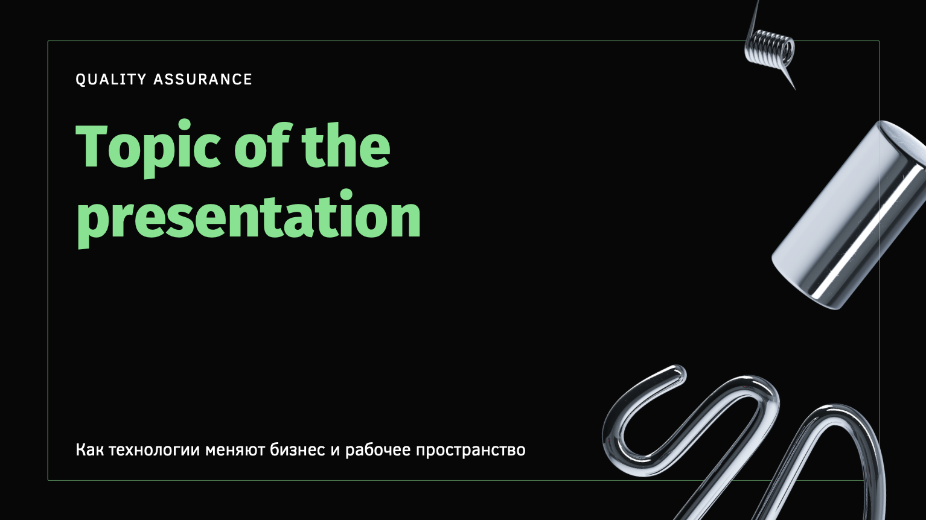
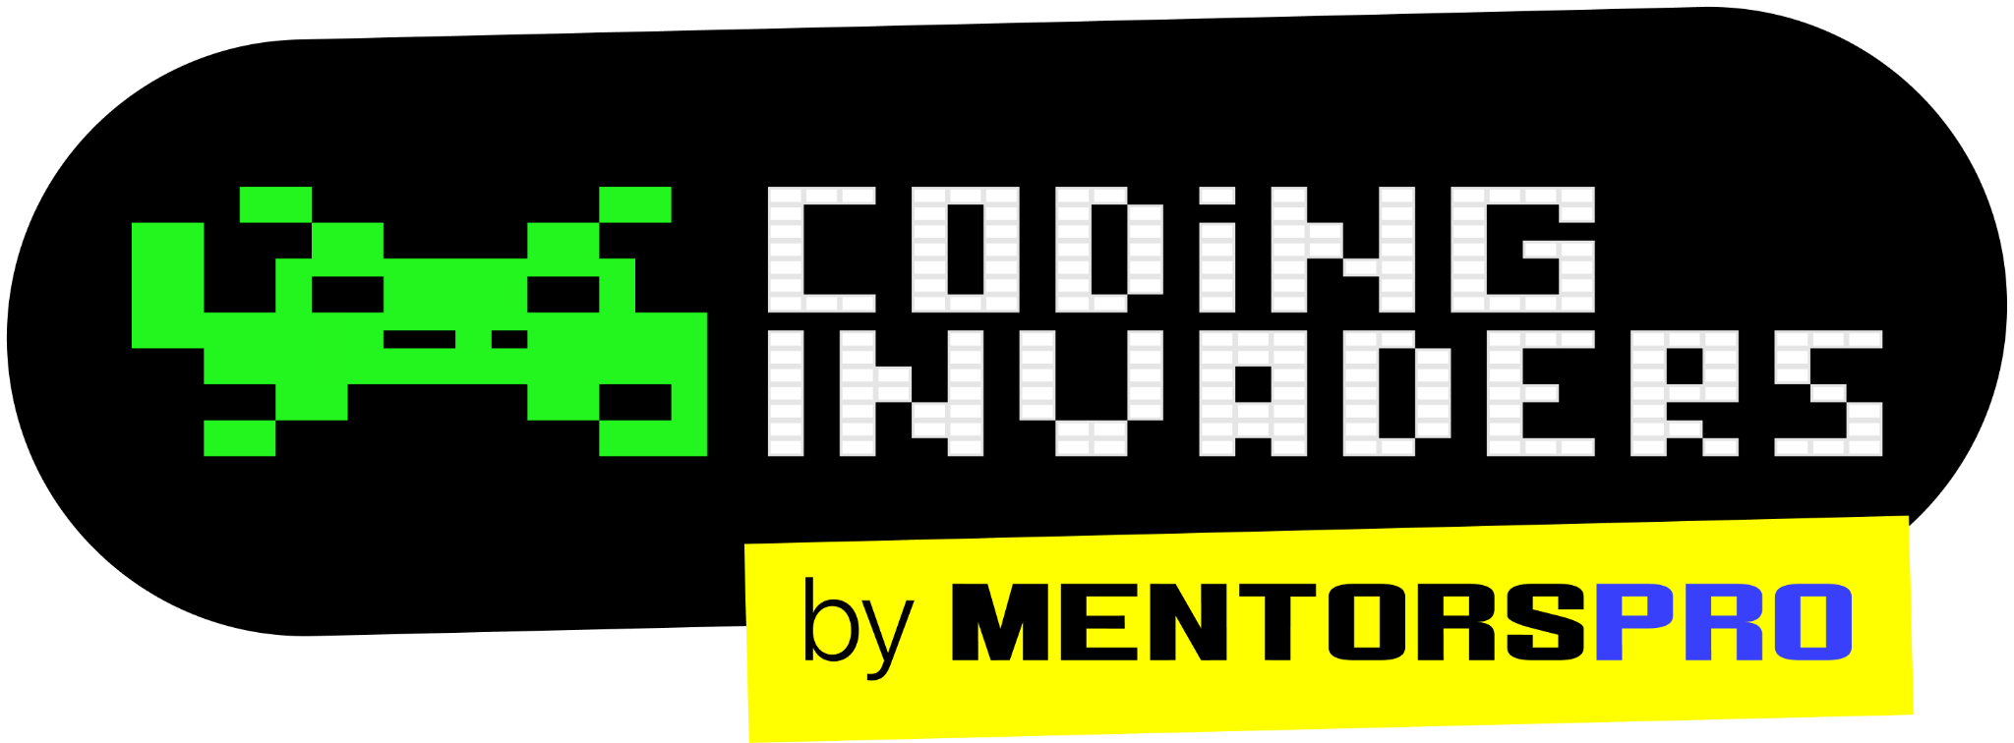
QA Automation Engineer
“Software Testing Types”
Session -4
Content Title
Notes:
Title - Fira Sans, 50pt
Subtitle - Fira Sans, 16pt

Slide 2
Types of Testing
Smoke Testing
Sanity Testing
Installation Testing
Black box testing
White Box Testing
System Testing
Usability Testing
Regression Testing
Defect Retesting
Performance Testing

Slide 3
Installation Testing Installation testing is performed to check the software has been correctly installed with all the inherent features and that the product is working as per expectations. Installation testing is check that software application is successfully installed & it is working as expected after installation. Installation Testing is also called as Implementation Testing. Note: We need to Perform Installation testing for Desktop based application.

Slide 4
Uninstallation Testing
Uninstall testing is performed to check whether the user can be able to uninstall the application with out any error.
Also need confirm that not impacting the other working features in the system which was previously working fine.

Slide 5
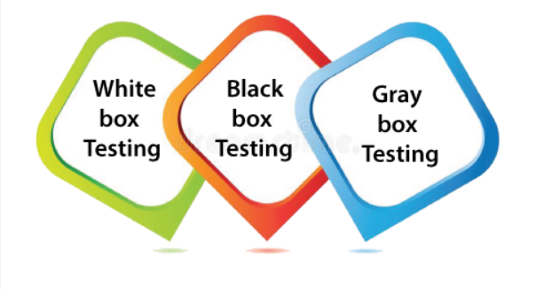
Testing Methodology

Slide 6
Whitebox Testing Performing testing on application with structure knowledge or coding knowledge is called Whitebox testing. Or Testing each line of code is called Whitebox testing. A resource who is having coding knowledge can perform Whitebox testing in a project. The name of this testing is white because code is visible. Ex. Development team.

Slide 7
Blackbox Testing Performing testing on application with functional knowledge is called Blackbox testing. A resource who is having functional knowledge can perform blackbox testing in a project. Ex. Testing team.

Slide 8
Difference Between Whitebox Testing and Blackbox Testing
Whitebox Testing | Blackbox Testing
The White Box Test is a method used to test a software taking into consideration its internal functioning. | The Black Box Test is a test that only considers the external behavior of the system; the internal workings of the software is not taken into account.
It is carried out by Developer | It is carried out by testers.
It is the most time consuming. | It is the least time consuming.
It is the logic testing of the software. | It is the behavior testing of the software.
5. Programming knowledge is needed to perform White Box testing. | 5. Programming knowledge is not needed to perform Black Box testing.
6. It is also known as clear box testing, code-based testing, structural testing, and transparent testing. | 6. It is also known as functional testing and closed box testing.

Slide 9
Graybox Testing Gray box testing is a combination of white box and Black box testing. It can be performed by a person who knew both coding and testing. It is also called as Hybrid Testing

Slide 10
System Testing System testing is defined as testing of complete or fully integrated software. This testing falls in Black box testing where we don’t need knowledge of code. System testing performed after sanity testing. System Testing is also called as End to End testing.

Slide 11
Usability Testing Usability Testing is a type of testing, that is done from an end user's perspective to determine if the system is easily usable Usability testing mainly focuses on user’s ease of using application, flexibility of application to handle controls and ability of application to meet its objectives. Verifying the user friendliness of the application in terms of colors, logos, images, font and alignment of the pages is called Usability testing. Note: Usability testing is also called User Experience Testing.

Slide 12
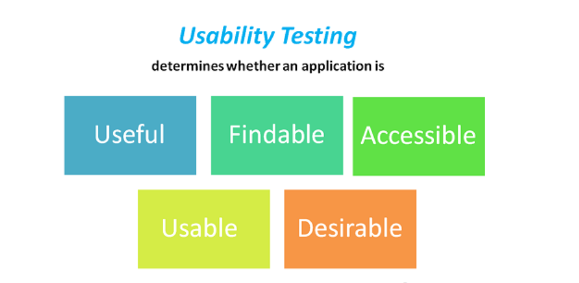

Slide 13


Slide 14
Perform Sanity Testing and Usability Testing on Car
Sanity Testing | Usability Testing
1. Verifying whether Car is starting or not | 1. Verifying the colour of the Car
2. Verifying whether break is working or not | 2. Verifying whether the Car is comfortable or not
3. Verifying gear and accelerator is working or not | 3. Verifying the company name and logo.
4. Verifying whether the Car is riding smoothly or not | 4. Verifying the interior of the car
5. Verifying whether Clutch is working or not | 5. Verifying the shape and size of the car

